Slide 1
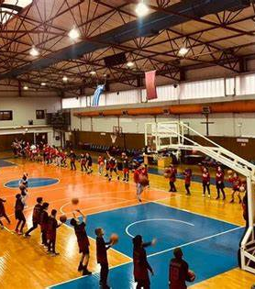
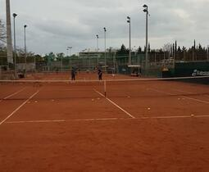
PICTURES OF APOLLON KALAMARIAS
Apollon Kalamarias was founded on January 24, 1926 in Kalamaria by Pontian refugees.
The original idea was to establish a club with the aim of spreading the rich musical tradition of Pontian.

Slide 2
Apollon Kalamarias
The club currently maintains the following departments: football, basketball, volleyball, athletics, swimming, tennis, table tennis, boxing and weightlifting. In the past it was active in a variety of other sports.

